Slide 1
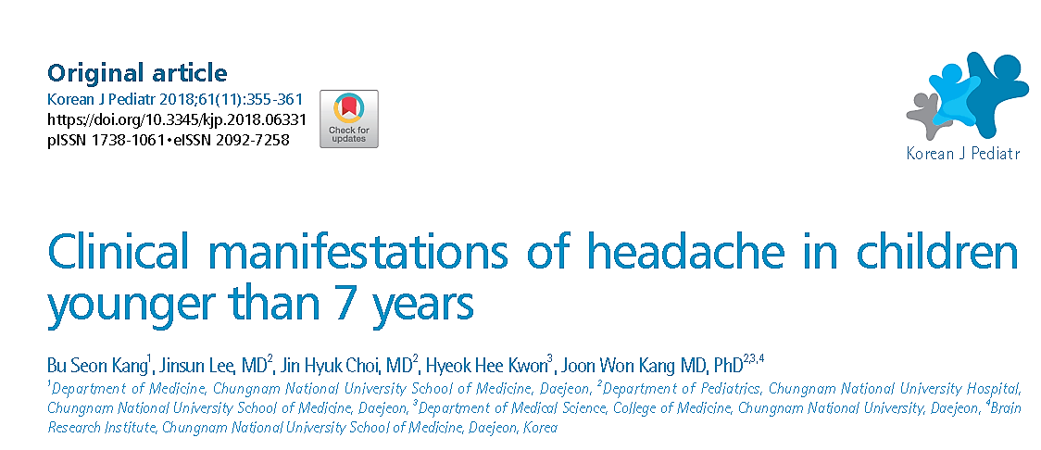
Critical appraisal of differential diagnosis
Jacob

Slide 2
Background
Headache is considered one of the most common symptoms during childhood
There are considerable differences between the headaches of children and adults in terms of pain duration, laterality, and other factors
The objective of the present study was to examine various aspects and progression of headaches in children younger than 7 years.

Slide 3
Population: children < 7 years with chief complaints of headache
Outcome: To examine various aspects and progression of headaches in children younger than 7 years
Study: Prospective observational study

Slide 4
How serious is the risk of bias?
Did the study patients represent the full spectrum of those with the clinical problem?
Did the investigator define the clinical problem clearly?
No, Headache was not defined , all patients with complaints of headache were taken
Were the study population collected from all relevant clinical settings?
Study population taken from paediatric department , not given if emergency patients were taken??
Selection bias as this was a tertiary centre

Slide 5
Were study patients recruited consecutively from the clinical setting?
Not specified
Lot of patients were excluded, criteria not mentioned
Did the study patients exhibit the full clinical spectrum of the presenting problem?
Probably no, No bleeds/ infarcts seen in the diagnosis, most of the diagnosis are benign

Slide 6
Was the diagnostic evaluation definite?
Was the diagnostic evaluation sufficiently comprehensive?
Yes, adequate history was taken, physical evaluation was done, relevant investigations like EEG, MRI, TSH were done
Was the diagnostic evaluation consistently applied to all patients?
Yes, patients were evaluated in detail, necessary tests were all done according to protocol

Slide 7
Were the criteria for all candidate diagnoses explicit and credible?
Yes, International Classification of Headache Disorders (ICHD) 3-beta criteria was applied
Were the diagnostic labels assigned reproducibly?
Yes, the criteria was reproducible

Slide 8
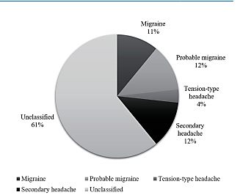
Were there few patients left with undiagnosed conditions?
61% were undiagnosed

Slide 9
For undiagnosed patients, was follow-up sufficiently long and complete?
Yes
The mean follow-up period was 22.0±9.8 months (range, 5.0–37.4 months) from the investigation day 1

Slide 10
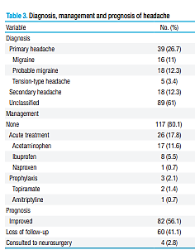
What are the results?
What were the diagnoses and their probabilities?

Slide 11
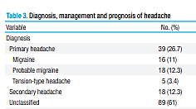
How precise are the estimates of disease probability?
0.068- 0.170 0.202- 0.344
0.068- 0.170
0.079- 0.186
0.014- 0.077
0.079- 0.186
0.528- 0. 684

Slide 12
How can I apply the results to patient care?
Are the study patients and clinical setting similar to mine?
Differences in prevalence of headache with racial differences present in adults - But in paediatric population?
Selection bias- This was a tertiary centre and not representative of the general population
Majority of the diagnosis were unclassified- there would have been a definite error in the individual disease probability

Slide 13
Is it unlikely that the disease possibilities or probabilities have changed since the evidence was gathered?
No
No change in the criteria of headache have been made in the Classification of Headache Disorders (ICHD) since the study
No newer diagnostic modalities have evolved since then.

Slide 14
Thank you

