Slide 1
Critical Appraisal of a Screening Test
Anil Mathew Philip

Slide 2
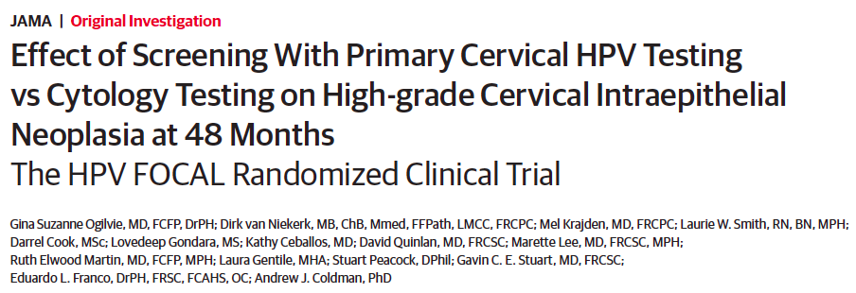

Slide 3
Background
Cervical cancer screening with cytology is one of the most widely used cancer control interventions
Programs have decreased cervical cancer morbidity and mortality
Approximately 99.7% of all cervical cancers are associated with a persistent cervical infection with an oncogenic human papillomavirus (HPV) genotype preceding the invasive tumor
Screening using HPV testing has been evaluated and there are meta analysis showing combined cytology and HPV testing to be superior
Clinical oncology societies still are not willing to acept it as an appropriate screening test

Slide 4
Aim
To evaluate if cervical cancer screening with HPV testing compared to cytology show a lower likelihood ratio of CIN grade 3 or worse at 48 months

Slide 5
Study Design
Population: Women aged 25-65 years with a personal health number in British Columbia, Canada
Intervention Group: Primary HPV testing,
Control Group: Liquid based cytology
Saftey group: Primary HPV→ LBC if positive, received same management as the intervention group
Outcome: Rates of CIN3+ at 48 months in the intervention and control groups
Timeline: followed up for 48 months

Slide 6
Intervention Group
HPV testing
+ve →LBC
-ve → recall at 48 months
12 months LBC + HPV
If ASCUS→ colposcopy
-ve → exit at 48 months
+ve → colposcopy

Slide 7
Control Group
LBC
If ASCUS
-ve → recall at 48 months
HPV testing
+ve → colposcopy
-ve→ LBC at 12 months
If ASCUS→ colposcopy

Slide 8
Inclusion Criteria:
women in British Columbia, Canada
with a personal health number
aged 25 to 65 years who had not had a Papanicolaou test in the previous 12 months
Exclusion Criteria:
Pregnant
HIV positive or receiving immunosuppressive therapy
History of CIN2+/Invasive cervical cancer
Total hysterectomy

Slide 9
Statistical Analysis
Rate of CIN3+ detection in women screened by combined HPV and cytology who had previously been screened by cytology was 8.1 per 1000
It was assumed that this would be applicable to control group and 0.5 for intervention
It was assumed that at least 80% of those randomized would be eligible and return for screening at 48 months.
Specifying a 2-sided α = .05 and power = 0.90, then 9400 participants were required per arm in the control and intervention groups.

Slide 10
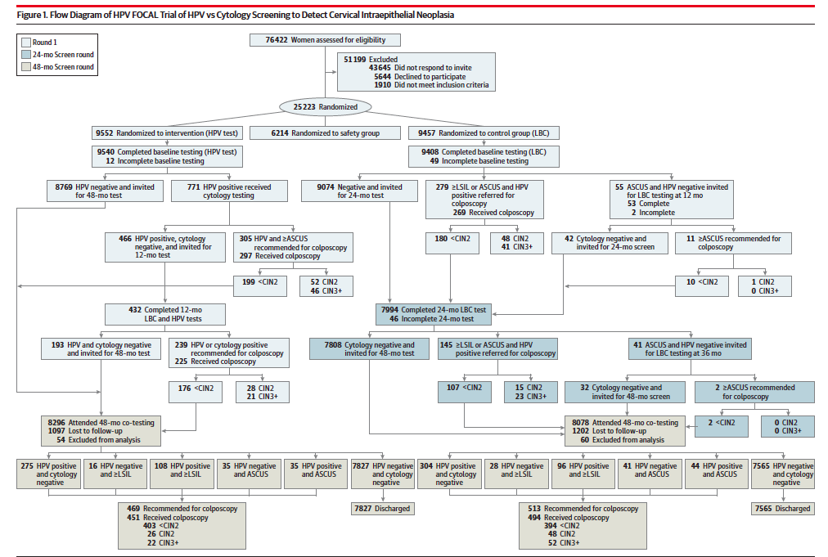

Slide 11
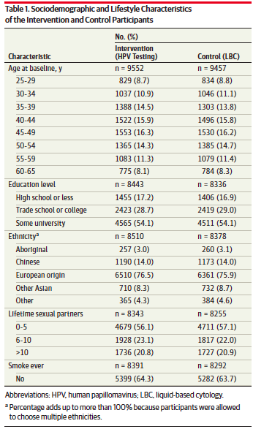
Baseline Characteristics

Slide 12
Validity of the RCT
Study population: well defined
Outcomes: clearly defined
Randomization: 1:1:1 randomisation
Allocation concealement: Was done
Blinding: Double blinded until 24 months, unless baseline was positive
Sample size calculation: adequate
Baseline characteristics: well matched

Slide 13
How serious is the risk of bias?
Is there randomized control trial evidence addressing the impact of the intervention in asymptomatic people?
Meta-analysis have shown benefit for combined HPV and LBC testing.
This is a RCT, comparing HPV and LBC

Slide 14
What are the recommendations, and will they help you in caring for patients?
Was the data identified , selected and combined in an unbiased fashion?
Yes, data was collected from a well conducted randomised control trial.

Slide 15
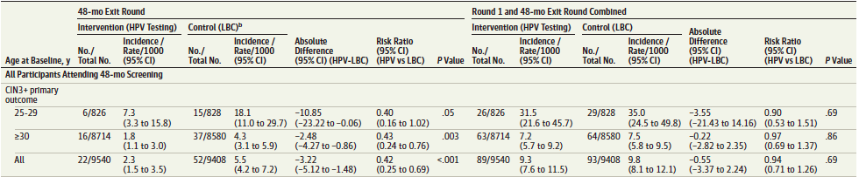
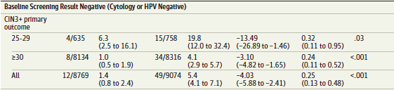
Results
At Round (12/24 months)
ARR= 0.5
NNT=200
48 month Exit Round
ARR= 3.2
NNT= 31.5
In exit round at 48 months showed significant difference in the pick up rate of CIN3+, but at 72 month follow up incidence was similar(results not shown)

Slide 16
By adding cytology to the intervention group, an additional 3 CIN2+ lesions were detected in HPV-negative women.
In contrast, by adding HPV testing to the control group, HPV testing detected 25 CIN2+ lesions that would not have been detected by cytology alone

Slide 17
What are the benefits?
The rate of colposcopy procedures would reduce significantly, reducing the risk of harm due to the procedure
What are the harms?
Costs of the HPV testing are much higher than that of LBC. So in the case of positive HPV→LBC followed by colposcopy, hence cumulative charges would be higher

Slide 18
How do benefits and harms compare in different people and with different screening strategies?
Earlier detection of significant lesions→
lead to more frequent screening and early intervention

Slide 19
What is the effect of individuals’ values and preferences?
Both the HPV testing and the LBC both have to be taken from cervical brushings, which is a semi-invasive procedure. Hence there may not be a procedural harm difference between the two groups.
But in resource limited setting, testing with LBC may be more cost appropriate, as the number of cummulative test may be less.

Slide 20
What is the effect of uncertainty associated with the evidence?
The p values were all significant and this was a well conducted RCT with large sample sizes.

Slide 21
What is the cost-effectiveness?
A cost effectiveness trial has not be done and should be done in the future.
In CMC HPV testing costs: 1250/-
LBC testing: 650/-

