Slide 1
Critical Appraisal of Cohort Study
Jasper Rathinam J

Slide 2
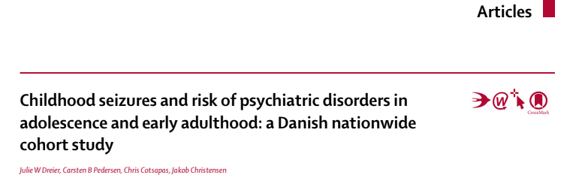

Slide 3
Background
Paediatric seizures—including febrile seizures and epilepsy—aﬀect 4–5% of all children
Febrile seizures have generally been considered to have a favourable prognosis, with little or no long-lasting implications for child development
Epilepsy has been associated with an increased risk of adverse neuropsychiatric development
studies have reported a bidirectional relation between seizures and psychiatric illness, which suggests that associations arise from a shared underlying genetic susceptibility and pathophysiology

Slide 4
Study design
P : Patients from Denmark cohort – born in Denmark between 1978 - 2002
E : Any form of seizure in childhood
C : Those who did not have seizures in childhood
O : Outcome of Psychiatric morbidity
T : Followed up till 2012

Slide 5
Study design
This study was undertaken as a population-based follow-up study.
From Danish Civil Registration System, a cohort of all children born in Denmark between 1978 and 2002 and followed them up from their 10th birthday.
The Danish Civil Registration System includes virtually all individuals living in Denmark and contains continuously updated information on vital status and place of residence (including emigrations and immigrations).
Every individual in the register is assigned a unique personal identifcation number, which enables accurate linkage between a range of nationwide health and social registries.

Slide 6
Inclusion criteria
The study population was restricted to children who were alive and residing in Denmark on their 10th birthday and whose parents were both also born in Denmark
Excluded diagnosis of Cerebral Palsy , Intracranial Tumours ,CNS infections , head trauma

Slide 7
Study design
Follow up data was obtained from the registry
ICD- 8 for 1977-1993, and ICD 10 from 1994 was used to define exposure and outcome

Slide 8
exposure
Febrile seizure if the diagnosis was made between the age of 3 months and 5 years
Child to have epilepsy if he or she
received any epilepsy diagnosis before the age of 10 years

Slide 9
outcome
For all cohort members, any of the following outcomes were considered
mental and behavioural disorders due to psychoactive
substance abuse (ICD-10, F10–F19)
Schizophrenia and related disorders (ICD-10, F20–F29)
mood disorders (ICD-10, F30–F39)
anxiety, stress-related and somatoform disorders (ICD-10, F40–F48), and specifc personality disorders (ICD-10, F60–F60.9)

Slide 10
Are the results Valid?
Were the patients similar for prognostic factors that are known to be associated with the outcome(or did statistical adjustment level the playing field)?
Baseline Characters not given
Adjustment is mentioned for perinatal, demographic, and socioeconomic
factors , birthweight, gestational age, Apgar score at 5 min, and parental age at birth, maternal education (highest completed) and paternal income in the year the child turned 10 years old , parental psychiatric illness.

Slide 11
Were the circumstances and methods for detecting the outcome similar?
All health data in the country is entered in registry
Except patients who left country – but this group is excluded

Slide 12
Was the follow-up sufficiently complete?
Danish registry connected with all hospitals and claims completeness of follow up data
Patients who left the country were excluded

Slide 13
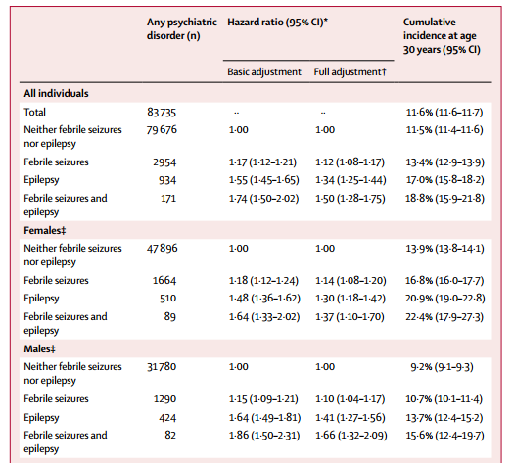
What are the results?
How strong is the association between exposure and outcome?

Slide 14
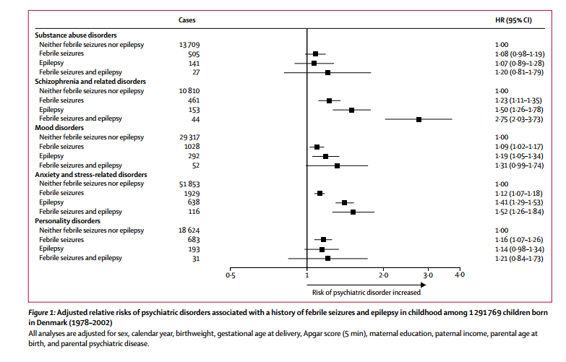

Slide 15
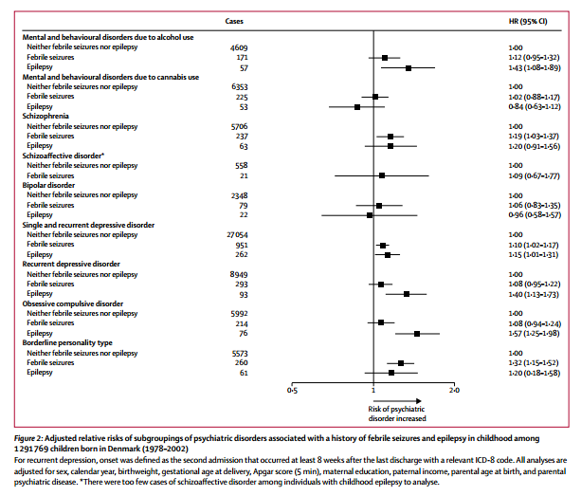

Slide 16
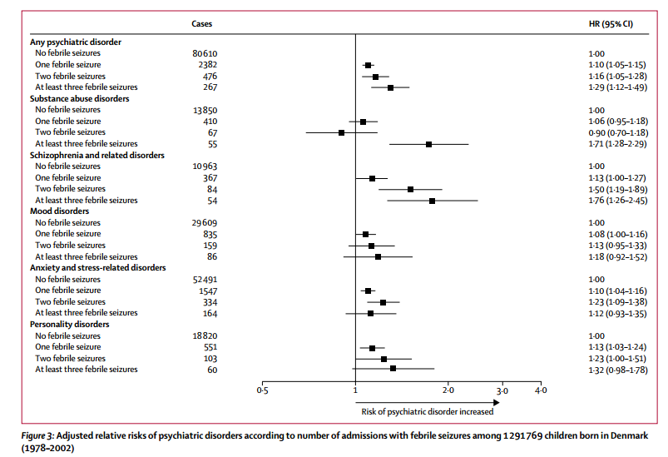

Slide 17
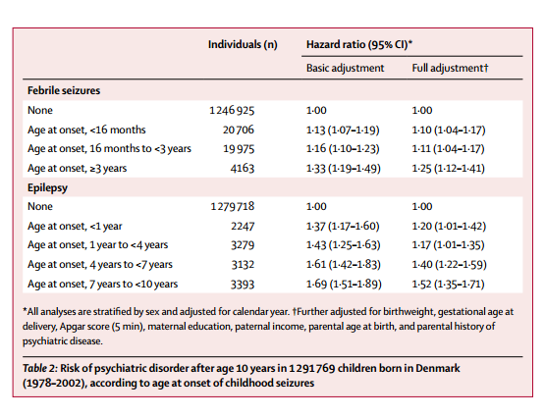

Slide 18
How precise was the estimate of the risk?
HR was about 1.5 with a significant 95% CI

Slide 19
How can I apply the result to patient care?
Were the study patients similar to the patient in my practice?
No
Danish population
Pathophysiology of the biological components of the bio-psycho-social model may be the same
Psycho-social parameters will be grossly different

Slide 20
Was follow-up sufficiently long?
Yes
Variable follow up duration though
Minimum follow up - 10 years

Slide 21
Is the exposure similar to what might occur in my patient?
Yes
Febrile seizures , Epilepsy are common disorders in India also

Slide 22
What is the magnitude of the risk?
Hazrads ratio was 1.6 .
Incidence of Psychitric disorder – 83,735/1291679 – 0.064 – 6.4%
Incidence in Exposed - 4059 /56889 – 0.071 – 7.1%
AR increase – 0.7%
NN to be exposed to develop 1 extra case of psychiatric disorder - 142
Are there any benefits that are known to be associated with exposure?
No

Slide 23
Conclusion
Epilepsy and Febrile Seizure have a definite statistically significant weak association with the development of Psychiatric disorder

