Slide 1
Critical Appraisal of a Systematic Review
Jasper Rathinam J

Slide 2
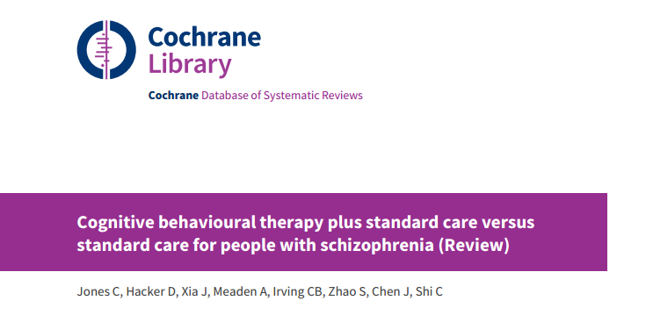

Slide 3
Background
Schizophrenia occurs in 1% of ppl in their lifetime
1 per 10,000 develop Schizophrenia every year
CBT has been a recommended add on therapy
Extensive new studies available after that and CBT has become more refined over the years
Despite being recommended ( by NICE guidelines) , many patients were waiting for CBT for > 1 year in many countries

Slide 4
PICOT
P : People with a current diagnosis of schizophrenia or closely related illness
I : CBT as add on to standard pharmacologic therapy
C : Standard of Care without CBT
O : Relapse and Short term and long term outcomes looked at in various studies
T : Ranging for 12 weeks to 4 years

Slide 5
Inclusion Criteria
Participants were people with a current diagnosis of schizophrenia or closely related illness such as schizoaffective disorder, diagnosed by any criteria, irrespective of gender or race.
We did not include trials where participants had a very late onset of illness (onset after the age of 60 years) or those where the majority of participants had disorders such as bipolar affective disorder, substance-induced psychosis.
If studies randomised people with a range of diagnoses, we only included trials where more than 50% of the participants had a diagnosis of schizophrenia or similar illness.

Slide 6
Intervention
For well defined CBT - the intervention must
clearly demonstrate the following components:
• a discrete psychological intervention, which is in addition to, and separate from, other therapeutic interventions (for example, behavioural family therapy);
• recipients establish links between their symptoms, thoughts, and beliefs, and consequent distress or problem behaviour
• the re-evaluation of their perceptions, beliefs, or reasoning relating to the target symptoms
Must be given by people with appropriate training and experience

Slide 7
ASSESSING THE CREDIBILITY OF THE STUDY
Did the review explicitly address a sensible clinical question?
Yes
Benefit of CBT to SOC was the question
Was the search for relevant studies exhaustive?
Yes, It was a Cochrane Review
Systematic searches of major resources (AMED, BIOSIS, CENTRAL, CINAHL, ClinicalTrials.Gov, Embase, MEDLINE, PsycINFO, PubMed, WHO ICTRP) and their monthly updates, ProQuest Dissertations and Theses A&I and its quarterly update, Chinese databases (CBM, CNKI, and Wanfang) and their annual updates, handsearches,
grey literature, and conference proceedings

Slide 8
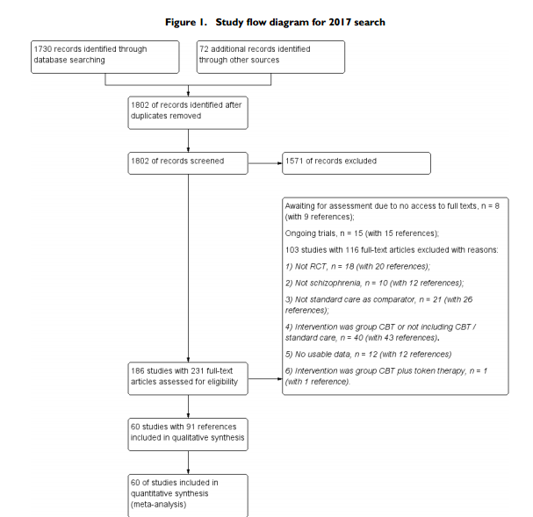

Slide 9
Were the assessments of the included studies reproducible?
2 independent reviewers screened the titles and abstracts of eligible studies.
Atleast 2 independent reviewers reviewed the full manuscripts for possible inclusion.
Disagreements were resolved through discussion.
10 % of studies were screened by another 2 reviewers to ensure quality

Slide 10
Were the primary studies of high methodologic quality?
Internal validity of individual trials assessed tool described in the Cochrane Handbook for Systematic Reviews of Interventions (Higgins 2011b )
Evaluates how randomisation sequence was generated, how allocation
was concealed, the integrity of blinding at outcome measurement,
the completeness of outcome data, selective reporting, and other
biases.

Slide 11
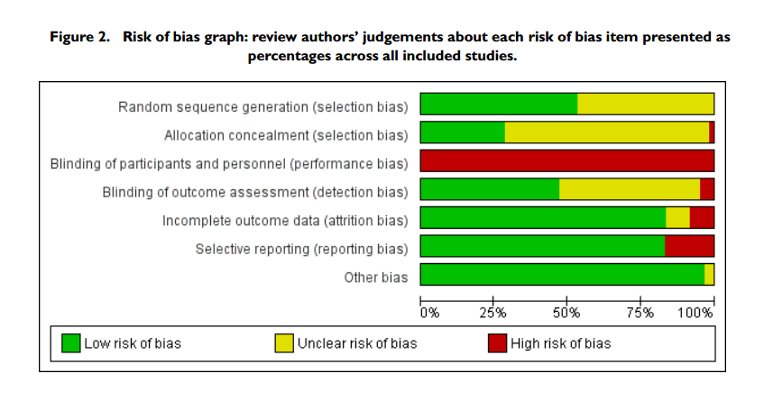

Slide 12
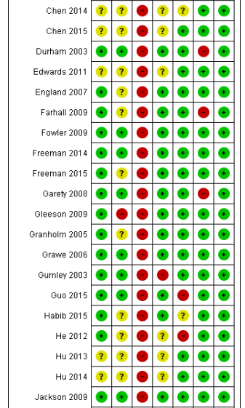
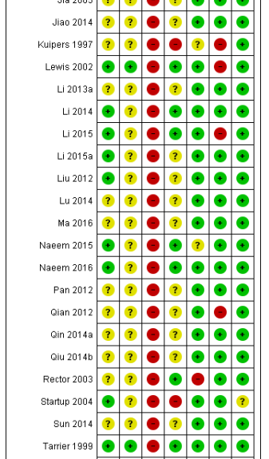
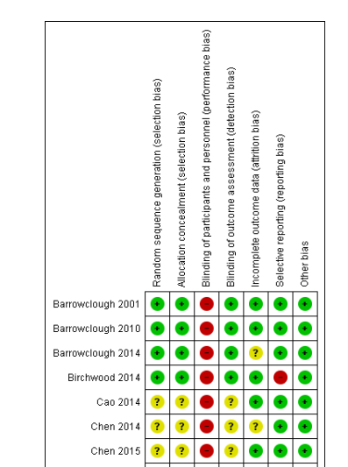
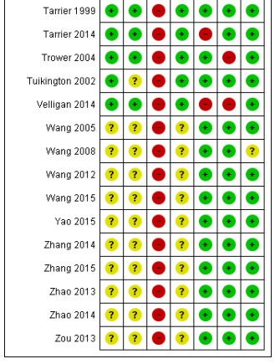

Slide 13
What were the results ?
Did the review present results that are ready for clinical application?
Yes
Did the review provide a rating for confidence in effect estimates or provide
the information I need to evaluate confidence (e.g. risk of bias in included
studies)?
Yes

Slide 14
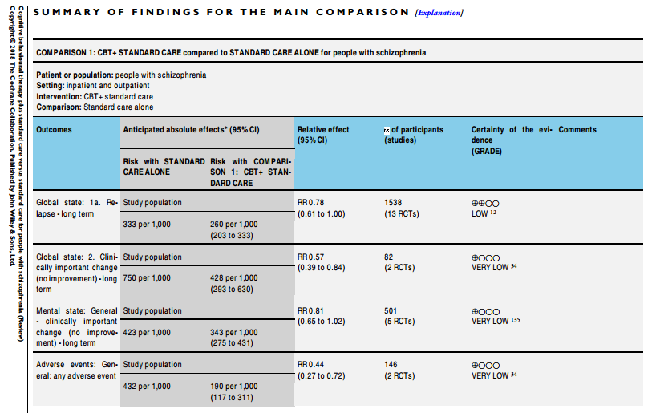

Slide 15
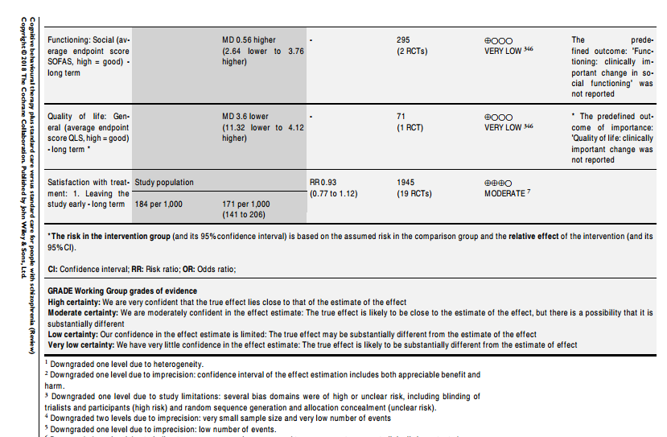

Slide 16
Are the results inconsistent across studies (i.e., inconsistency)?
Some Variations
Measured by I2
Long term outcome had significantly high I2

Slide 17
Do you consider the magnitude of treatment effect large (e.g. RR> 2.0 or <0.5)?
Control Event Rate : 33.3%
Experimetal Event rate : 26%
ARR – 7.3%
NN to avoid a relapse : 13.7 = 14
Cost of CBT : Vary from country to country
In our setting , much cheaper. Secondary costs and time will matter.

Slide 18
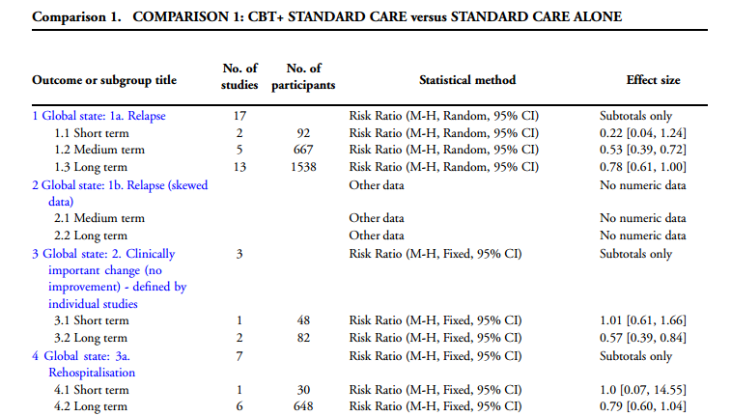
Overall confidence in the estimates?

Slide 19
Would your decisions differ if either boundary of the confidence interval represented the truth ?
Still Results are significant
Most end of CI are less than 1

Slide 20
Is there a high likelihood of publication bias?
Less likely as all studies were included
Both positive and negative studies were included

Slide 21
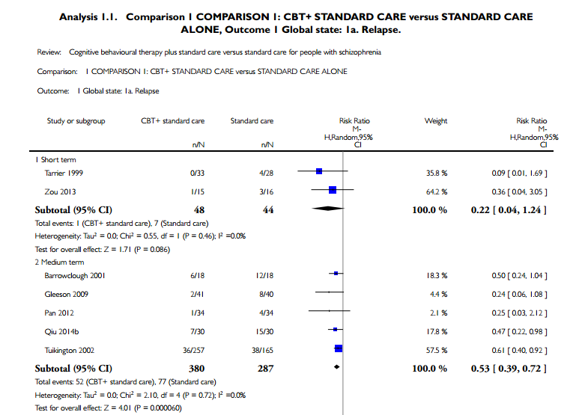

Slide 22
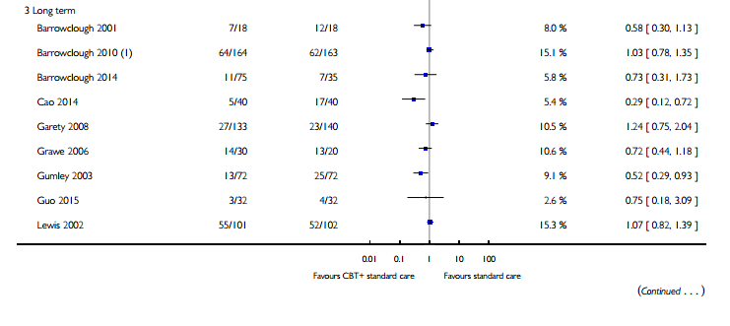
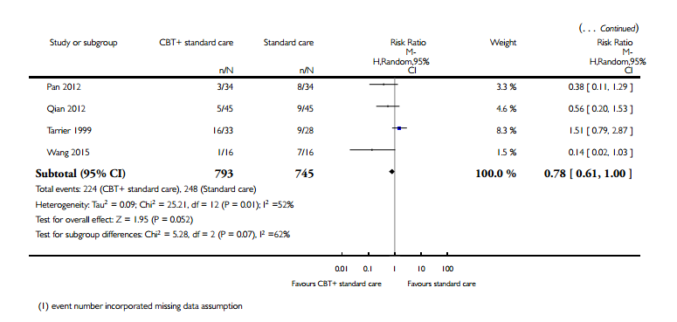

Slide 23
Do the systematic review population, intervention, comparison, and outcomes fit the patient at hand (i.e.,indirectness)?
Clinically Relevant outcomes were looked at
Intervention – variable among studies
Patient : Baseline characters not mentioned as whole , Individual studies had varied characters
Most studies were from China and West
Epidemiological differences in Schizophrenia well established in previous studies

Slide 24
Would I use the results of this study for my patients?
Yes
Cheap intervention , non pharmacological with good benefit.

Slide 25
Thank You

